Slide 1
Ec2, IAM and Load Balancers
By Harsha

Slide 2
Agenda
Introduction to EC2, IAM, Load Balancers, SNS
Why IAM and Load Balancing in AWS
Real-World Case Study
Best Practices
Conclusion & Q&A

Slide 3
What is EC2?
Provides on-demand, scalable computing capacity in the AWS Cloud.
Allows users to run applications on virtual machines.
Features: Secured, Flexible, Customizable, Pay-as-you-go
Uses: Web hosting, Application deployment, High-performance computing

Slide 4
What is IAM?
Helps to securely control access to AWS resources.
provides the infrastructure necessary to control authentication and authorization.
Common tools: AWS IAM, Azure AD, Okta

Slide 5
Why IAM?
Authentication identifies who the user is.
Authorization determines what resources the user can access.
User Management involves organizing users into roles, groups, and applying access policies.

Slide 6
What is a Load Balancer?
Load balancing is the method of distributing network traffic equally across a pool.
Advantages:
High availability
Scalability
Secured
High performance

Slide 7
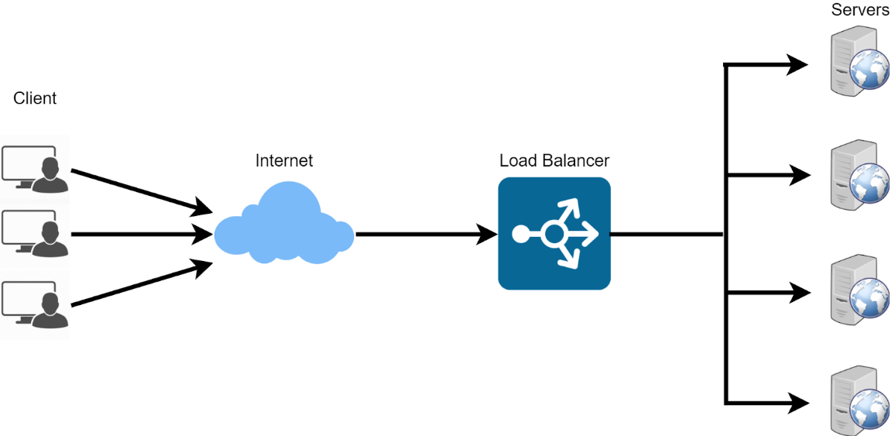
How Load balancer works?

Slide 8
Types of Load Balancers
Application Load balancing (Layer 7 , HTTP, HTTPS)
Network Load balancing (Layer 4, TCP/UDP)
Gateway Load balancing (deploy, scale, and manage virtual appliances, such as firewalls)
Classic Load balancing

Slide 9
What is SNS?
Provides message delivery from publishers (producers) to subscribers (consumers).
publishers send messages to a topic, which acts as a communication channel.
We can Subscribe through Email/message for services which we are using

Slide 10
Case Study – Ec2 (Printo)
Challenge: An E-commerce startup has experienced rapid growth in customer base and website traffic. Delivering and tracking the good and services became challenge.
Solution: Added more servers as per requirement, used Load balancers and Auto-Scaling services and AWS Cloud Watch for monitoring.

Slide 11
Case Study – IAM (Infosys)
Challenge: A leading multinational consumer goods company faced high costs and security risks due to manual, error-prone Identity and Access Management.
Solution: Implemented IAM for access control for people, process, technology and established a governance framework.
Implemented Single Sign-on (SSO) solution, MFA by integrating business application using cloud.

Slide 12
Case Study – Load balancing (Dream 11)
Issue: It’s an Online gaming platform, faced extreme and unpredictable traffic surges due to its nature as a fantasy sports.
Challenges:
Unpredictable traffic spikes
Performance drops
Manual scaling challenges
Solution: Deployed 100+ ELB’s to distribute traffic, Auto-Scaling, Load testing and Monitoring.

Slide 13
Best Practices
IAM:
Principle of Least Privilege
Use of MFA
Role-based access control (RBAC)
Load Balancers:
Health checks
Auto-scaling integration

Slide 14
Q&A
Any questions?

Slide 15
THANK YOU!!

